Slide 1
Introduction to Fuzzy Logic
Contents
Definitions
Bit of History
Fuzzy Applications
Fuzzy Sets
Fuzzy Boundaries
Fuzzy Representation
Linguistic Variables and Hedges

Slide 2
Definition
Fuzzy logic is not logic that is fuzzy, but logic that is used to describe fuzziness.
Fuzzy logic is the theory of fuzzy sets, sets that calibrate vagueness.
Fuzzy logic is based on the idea that all things admit of degrees. Temperature, height, speed, distance, beauty – all come on a sliding scale.
  The motor is running really hot.
  Tom is a very tall guy.
The concept of a set and set theory are powerful concepts in mathematics. However,
the principal notion underlying set theory, that an element can (exclusively) either
belong to set or not belong to a set, makes it well impossible to represent much
of human discourse. How is one to represent notions like:
  large profit
  high pressure
  tall man
  moderate temperature
Ordinary set-theoretic representations will require the maintenance of a crisp
differentiation in a very artificial manner:
  high
  not quite high
  very high … etc.

Slide 3
Definition
Many decision-making and problem-solving tasks are too complex to be understood quantitatively, however, people succeed by using knowledge that is imprecise rather than precise.
Fuzzy set theory resembles human reasoning in its use of approximate information and uncertainty to generate decisions
It was specifically designed to mathematically represent uncertainty and vagueness and provide formalized tools for dealing with the imprecision intrinsic to many problems
Boolean logic uses sharp distinctions. It forces us to draw lines between members of a class and non-members. For instance, we may say, Tom is tall because his height is 181 cm. If we drew a line at 180 cm, we would find that David, who is 179 cm, is small

Slide 4
Bit of History
Fuzzy, or multi-valued logic, was introduced in the 1930s by Jan Lukasiewicz, a Polish philosopher. While classical logic operates with only two values 1 (true) and 0 (false), Lukasiewicz introduced logic that extended the range of truth values to all real numbers in the interval between 0 and 1.
For example, the possibility that a man 181 cm tall is really tall might be set to a value of 0.86. It is likely that the man is tall. This work led to an inexact reasoning technique often called possibility theory
In 1965 Lotfi Zadeh, published his famous paper “Fuzzy sets”. Zadeh extended the work on possibility theory into a formal system of mathematical logic, and introduced a new concept for applying natural language terms. This new logic for representing and manipulating fuzzy terms was called fuzzy logic

Slide 5
Motivation of “Fuzzy Logic”
  It’s motivated by observing that human reasoning can utilize concepts & knowledge that don’t have well defined sharp boundaries.
  It tries to alleviate difficulties in developing & analyzing complex systems encountered by conventional mathematical tools

Slide 6
Fuzzy System
Fuzzy system (FS) includes FL & Fuzzy set theory
FS can simultaneously handle numerical data & linguistic knowledge
Many real world problems can be modeled & simulated with the help of FS
Expert system design have become much easy now because their domains are inherently fuzzy

Slide 7
Elements of Fuzzy System
Input Variables output Variables
X1 Y1
X2 Y2
Xn Y3
Fuzzy Rule Base
Fuzzification
Fuzzy Inferencing
Defuzzification
Membership Function

Slide 8
Fuzzy System elements
Input Vector : X = [x1 , x2, . . . xn ] T are crisp values, which are transformed into
fuzzy sets in the fuzzification block.
Output Vector : Y = [y1 , y2, . . . ym ] T comes out from the defuzzification block,
which transforms an output fuzzy set back to a crisp value.
Fuzzification : a process of transforming crisp values into grades of membership for
linguistic terms, "far", "near", "small" of fuzzy sets.
Fuzzy Rule base : a collection of propositions containing linguistic variables; the
rules are expressed in the form:
If (x is A ) AND (y is B ) . . . . . . THEN (z is C)
where x, y and z represent variables (e.g. distance, size) and
A, B and Z are linguistic variables (e.g. `far', `near', `small').
Membership function : provides a measure of the degree of similarity of elements
in the universe of discourse U to fuzzy set.
Fuzzy Inferencing : combines the facts obtained from the Fuzzification with the
rule base and conducts the Fuzzy reasoning process.
Defuzzyfication: Translate results back to the real world values.

Slide 9
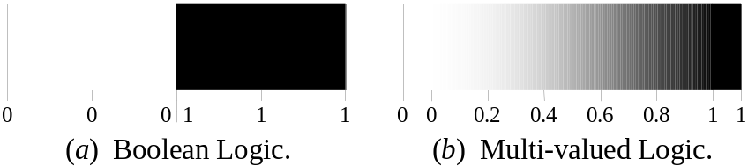
More Definitions
Fuzzy logic is a set of mathematical principles for knowledge representation based on degrees of membership.
Unlike two-valued Boolean logic, fuzzy logic is multi-valued. It deals with degrees of membership and degrees of truth.
Fuzzy logic uses the continuum of logical values between 0 (completely false) and 1 (completely true). Instead of just black and white, it employs the spectrum of colours, accepting that things can be partly true and partly false at the same time.

Slide 10
Principal Components of FL
The core technique of FL is based on 4 basic concepts:
Fuzzy Sets
Linguistic Variables
Possibility Distribution
Fuzzy IF-THEN rules

Slide 11
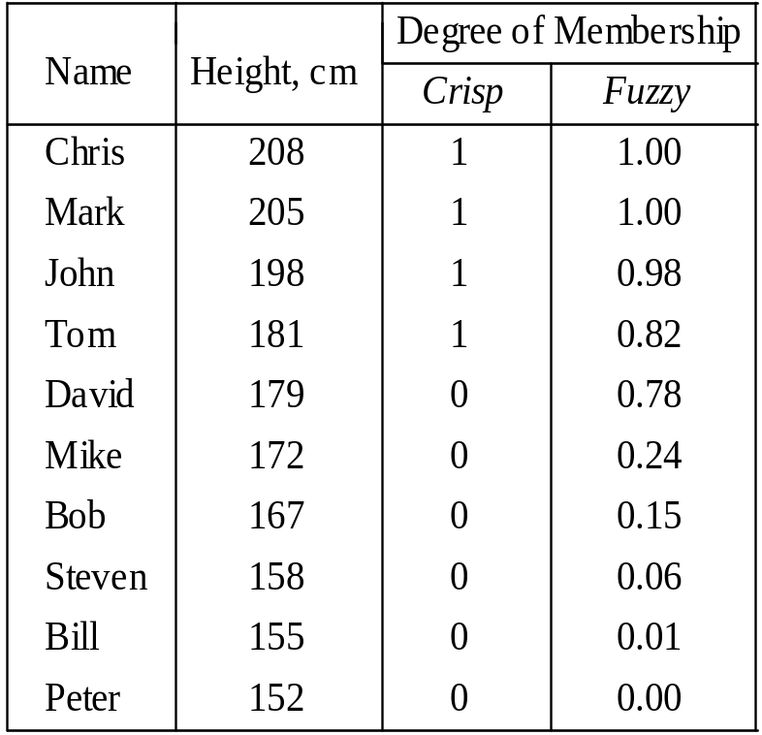
Fuzzy Sets
The concept of a set is fundamental to mathematics.
However, our own language is also the supreme expression of sets. For example, car indicates the set of cars. When we say a car, we mean one out of the set of cars.
Fuzzy set is a set with smooth un-sharp boundary
The classical example in fuzzy sets is tall men. The elements of the fuzzy set “tall men” are all men, but their degrees of membership depend on their height. (see table on next page)

Slide 12
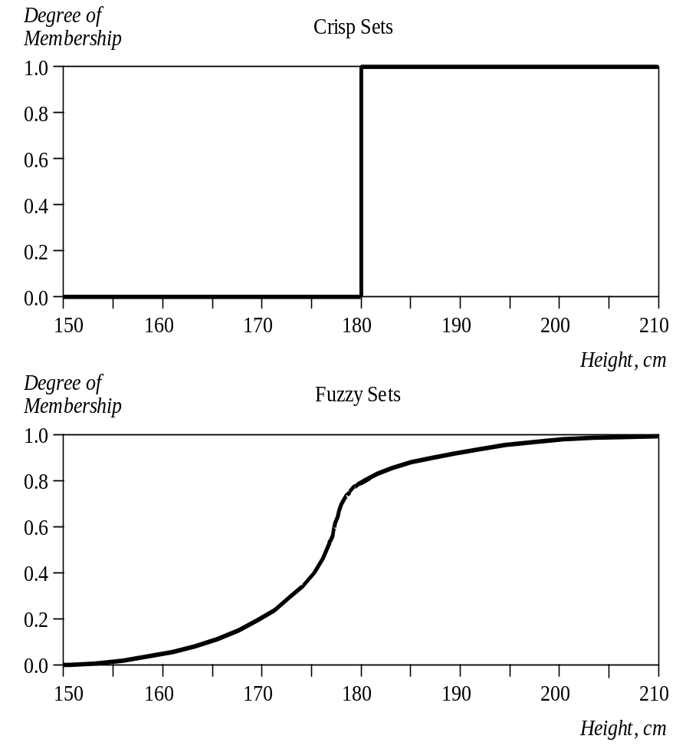
Crisp Vs Fuzzy Sets
The x-axis represents the universe of discourse – the range of all possible values applicable to a chosen variable. In our case, the variable is the man height. According to this representation, the universe of men’s heights consists of all tall men.
The y-axis represents the membership value of the fuzzy set. In our case, the fuzzy set of “tall men” maps height values into corresponding membership values.

Slide 13
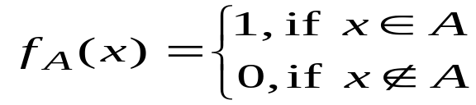
A Fuzzy Set has Fuzzy Boundaries
Let X be the universe of discourse and its elements be denoted as x. In the classical set theory, crisp set A of X is defined as function f_{A}(x) called the characteristic function of A:
f_{A}(x) : X → {0, 1}, where
This set maps universe X to a set of two elements. For any element x of universe X, characteristic function f_{A}(x) is equal to 1 if x is an element of set A, and is equal to 0 if x is not an element of A.

Slide 14
A Fuzzy Set has Fuzzy Boundaries
In the fuzzy theory, fuzzy set A of universe X is defined by function µ_{A}(x) called the membership function of set A
µ_{A}(x) : X → [0, 1], where µ_{A}(x) = 1 if x is totally in A;
µ_{A}(x) = 0 if x is not in A;
0 < µ_{A}(x) < 1 if x is partly in A.
This set allows a continuum of possible choices. For any element x of universe X, membership function µ_{A}(x) equals the degree to which x is an element of set A. This degree, a value between 0 and 1, represents the degree of membership, also called membership value, of element x in set A.

Slide 15
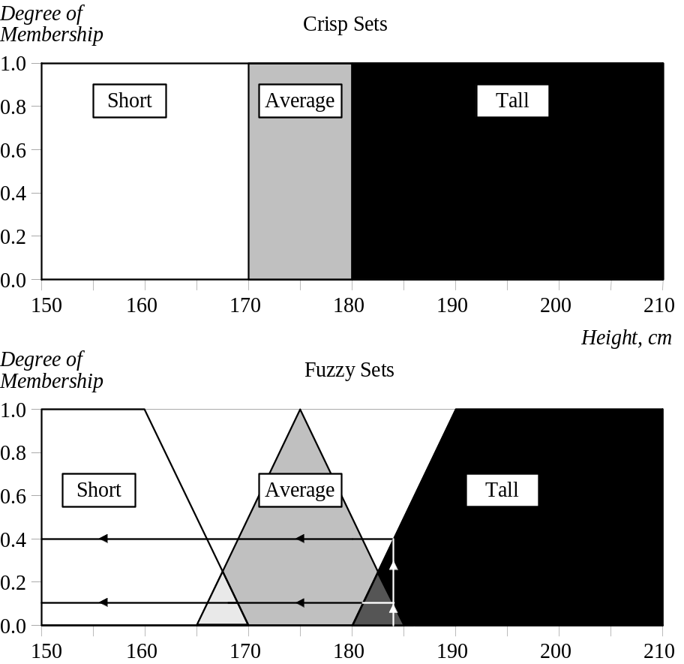
Fuzzy Set Representation
First, we determine the membership functions. In our “tall men” example, we can obtain fuzzy sets of tall, short and average men.
The universe of discourse – the men’s heights – consists of three sets: short, average and tall men. As you will see, a man who is 184 cm tall is a member of the average men set with a degree of membership of 0.1, and at the same time, he is also a member of the tall men set with a degree of 0.4.

Slide 16
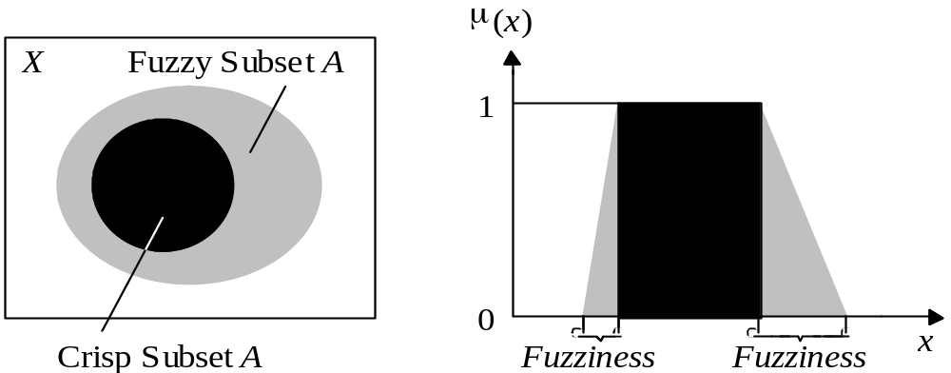
Fuzzy Set Representation
Typical functions that can be used to represent a fuzzy set are sigmoid, gaussian and pi. However, these functions increase the time of computation. Therefore, in practice, most applications use linear fit functions.

Slide 17
Linguistic Variable
A LV enables its values to be described both –
Qualitatively by a linguistic term (a symbol serving as a name of a fuzzy set)
Quantitatively by a corresponding MF which expresses the meaning of the Fuzzy set
Example:
a sentence ‘Trading quantity is heavy’ uses a a fuzzy set HEAVY to describe the quantity of a stock market trading in one day, whereas the linguistic variable is TRADING QUANTITY

Slide 18
Possibility Distribution
It provides constraints on the value of a LV imposed by assigning it a fuzzy set
In general, when a FS A is assigned to a LV X, the assignment results in a possibility distribution of X which is defined by MF of A
Π_{X}(x) = μ_{A}(x)
The possibility distribution states the degree of the possibility for the variable to take a certain value without indicating the likelihood that the variable has such a value

Slide 19
Fuzzy Rules
Rule: if the annual income of a person > 120K then the person is rich
Problem:
  The antecedent does not represent a smooth transition into the rich category
  Modus ponens can’t deal with a situation where antecedent is partially satisfied
Fuzzy Rule: if the annual income of a person is HIGH then the person is rich
Logical Connectives: AND, OR, NOT
The consequent of a Fuzzy rule can be classified into 3 categories:
  Crisp Consequent: if <condition> then y = a, where ‘a’ is non-fuzzy numeric val /symbol
  Fuzzy Consequent: if <condition> then y = A, ‘A’ is the fuzzy set
  Functional consequent:
if x1 is A1 AND x2 is A2 AND…AND xn is An then y = a0 + ∑ aixi
  i=1 to n

Slide 20
Characteristics of Fuzzy Sets
The classical set theory developed in the late 19th century by Georg Cantor describes how crisp sets can interact. These interactions are called operations. Fuzzy sets also have well defined properties.
These properties and operations are the basis on which the fuzzy sets are used to deal with uncertainty on the one hand and to represent knowledge on the other.
For the sake of convenience, usually a fuzzy set is denoted as:
A = μ_{A}(x_{i})/x_{i} + …………. + μ_{A}(x_{n})/x_{n}
where μ_{A}(x_{i})/x_{i} (a singleton) is a pair “grade of membership” element, that belongs to a finite universe of discourse: A = {x₁, x₂, .., x_{n}}

Slide 21
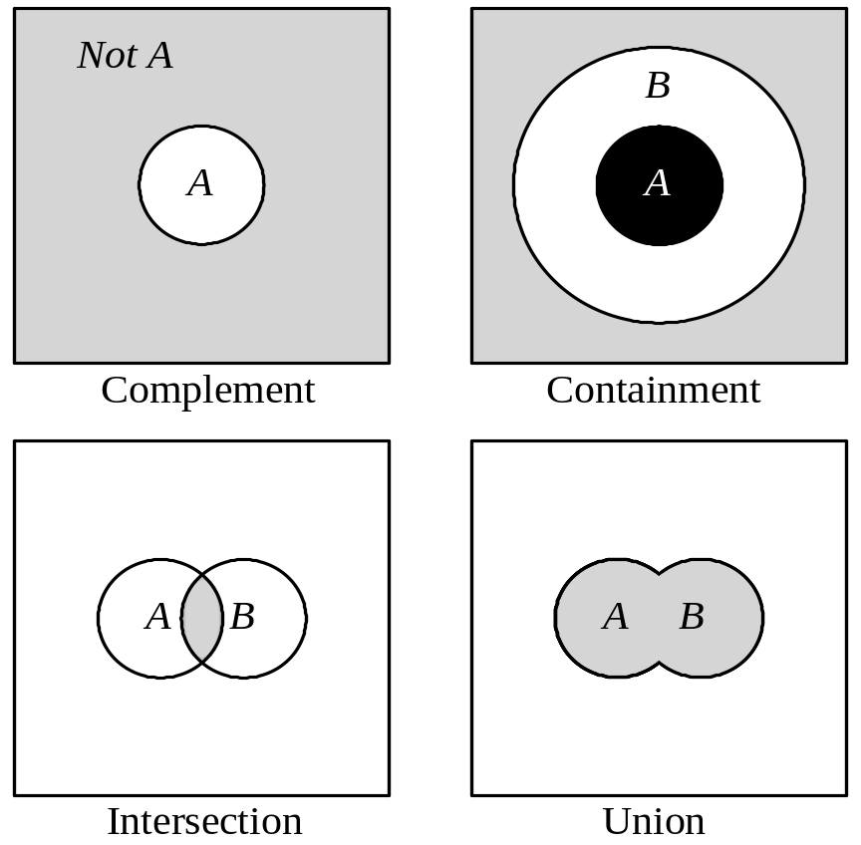
Operations of Fuzzy Sets

Slide 22
Complement
The complement of a set is an opposite of this set. For example, if we have the set of tall men, its complement is the set of NOT tall men. When we remove the tall men set from the universe of discourse, we obtain the complement.
If A is the fuzzy set, its complement ¬A can be found as follows:
μ¬_{A}(x) = 1 − μ_{A}(x)

Slide 23
Intersection
In classical set theory, an intersection between two sets contains the elements shared by these sets. For example, the intersection of the set of tall men and the set of fat men is the area where these sets overlap. In fuzzy sets, an element may partly belong to both sets with different memberships.
A fuzzy intersection is the lower membership in both sets of each element. The fuzzy intersection of two fuzzy sets A and B on universe of discourse X:
μ_{A}∩_{B}(x) = min [μ_{A}(x), μ_{B}(x)] = μ_{A}(x) ∩ μ_{B}(x),
where x∈X

Slide 24
Union
The union of two crisp sets consists of every element that falls into either set. For example, the union of tall men and fat men contains all men who are tall OR fat.
In fuzzy sets, the union is the reverse of the intersection. That is, the union is the largest membership value of the element in either set. The fuzzy operation for forming the union of two fuzzy sets A and B on universe X can be given as:
μA∪B(x) = max [μA(x), μB(x)] = μA(x) ∪ μB(x),
where x∈X

Slide 25
Equality
Fuzzy set A is considered equal to a fuzzy set B, IF AND ONLY IF (iff):
μ_{A}(x) = μ_{B}(x), ∀x∈X
A = 0.3/1 + 0.5/2 + 1/3
B = 0.3/1 + 0.5/2 + 1/3
therefore A = B

Slide 26
Inclusion
Inclusion of one fuzzy set into another fuzzy set. Fuzzy set A ⊆ X is included in (is a subset of) another fuzzy set, B ⊆ X:
μ_{A}(x) ≤ μ_{B}(x), ∀x∈X
Consider X = {1, 2, 3} and sets A and B
A = 0.3/1 + 0.5/2 + 1/3;
B = 0.5/1 + 0.55/2 + 1/3
then A is a subset of B, or A ⊆ B

Slide 27
Cardinality
Cardinality of a non-fuzzy set, Z, is the number of elements in Z. BUT the cardinality of a fuzzy set A, the so-called SIGMA COUNT, is expressed as a SUM of the values of the membership function of A, μ_{A}(x):
card_{A} = μ_{A}(x₁) + μ_{A}(x₂) + … μ_{A}(x_{n}) = Σμ_{A}(x_{i}), for i=1..n
Consider X = {1, 2, 3} and sets A and B
A = 0.3/1 + 0.5/2 + 1/3;
B = 0.5/1 + 0.55/2 + 1/3
card_{A} = 1.8
card_{B} = 2.05

Slide 28
Empty Fuzzy Set
A fuzzy set A is empty, IF AND ONLY IF:
μ_{A}(x) = 0, ∀x∈X
Consider X = {1, 2, 3} and set A
A = 0/1 + 0/2 + 0/3
then A is empty

Slide 29
Alpha-cut & Strong Alpha-cut
An α-cut or α-level set of a fuzzy set A ⊆ X is an ORDINARY SET A_{α} ⊆ X, such that: A_{α} or α_{A}={μ_{A}(x)≥α, ∀x∈X}.
Consider X = {1, 2, 3} and set A = 0.3/1 + 0.5/2 + 1/3
then A_{0.5} = {2, 3}, A_{0.1} = {1, 2, 3}, A₁ = {3}
Strong α-cut α⁺_{A} ={μ_{A}(x)>α, ∀x∈X}.
for the above example, 0.5⁺_{A} = {3}

Slide 30
Fuzzy Set Normality
A fuzzy subset of X is called normal if there exists at least one element x∈X such that μ_{A}(x) = 1.
A fuzzy subset that is not normal is called subnormal.
All crisp subsets except for the null set are normal. In fuzzy set theory, the concept of null-ness essentially generalises to sub-normality.
The height of a fuzzy subset A is the large membership grade of an element in A
height(A) = max_{x}(μ_{A}(x))

Slide 31
Fuzzy Sets Core, Support & Deg. Of Sub-set hood
Assume A is a fuzzy subset of X:
the support of A is the crisp subset of X consisting of all elements with membership grade:
supp(A) = {x⏐ μ_{A}(x) > 0 and x∈X}
the core of A is the crisp subset of X consisting of all elements with membership grade:
core(A) = {x⏐ μ_{A}(x) = 1 and x∈X}
Let’s assume that X is a finite universal set, A is not a null set & A, B ∈F(X), then deg. Of subsethood is defined as follows:
S(A, B) = |A∩B|/ |A|

Slide 32
Convex Set
Let S be a subset of the set of all real nos R.
S is said to be convex for any n, if for the elements s1, s2, …., sn ∈ S, s’ = λ₁s₁+ λ₂s₂+ λ₃s₃+…..+ λ_{n}s_{n} ∈ S, for all λ_{i} in [0, 1], such that Σ λ_{i} = 1
i=1 to n
A fuzzy set A is said to be a convex fuzzy set iff, each of its α-cuts is a convex set
Equivalently, A is convex iff,
μ_{A}(λx₁ + (1- λ)x₂) ≥ min (μ_{A}(x₁), μ_{A}(x₂)), where x₁, x₂ ∈ U, λ ∈[0, 1]

Slide 33
Fuzzy Set Math Operations
aA = {aμ_{A}(x), ∀x∈X}
Let a =0.5, and A = {0.5/a, 0.3/b, 0.2/c, 1/d}
then Aª = {0.25/a, 0.15/b, 0.1/c, 0.5/d}
Aª = {μ_{A}(x)ª, ∀x∈X}
Let a =2, and A = {0.5/a, 0.3/b, 0.2/c, 1/d}
then Aª = {0.25/a, 0.09/b, 0.04/c, 1/d}
Consider two fuzzy subsets of the set X, X = {a, b, c, d, e }
referred to as A and B , A = {1/a, 0.3/b, 0.2/c 0.8/d, 0/e}, B = {0.6/a, 0.9/b, 0.1/c, 0.3/d, 0.2/e}
Support:
  supp(A) = {a, b, c, d }
  supp(B) = {a, b, c, d, e }
Core:
  core(A) = {a}
  core(B) = {o}
Cardinality:
  card(A) = 1+0.3+0.2+0.8+0 = 2.3
  card(B) = 0.6+0.9+0.1+0.3+0.2 = 2.1

Slide 34
Fuzzy Sets Examples
Complement:
  A = {1/a, 0.3/b, 0.2/c 0.8/d, 0/e}
  ¬A = {0/a, 0.7/b, 0.8/c 0.2/d, 1/e}
Union:
  A ∪ B = {1/a, 0.9/b, 0.2/c, 0.8/d, 0.2/e}
Intersection:
  A ∩ B = {0.6/a, 0.3/b, 0.1/c, 0.3/d, 0/e}
aA:
  for a=0.5
  aA = {0.5/a, 0.15/b, 0.1/c, 0.4/d, 0/e}
Aª:
  for a=2
  Aª = {1/a, 0.09/b, 0.04/c, 0.64/d, 0/e}
a-cut:
  A_{0.2} = {a, b, c, d}
  A_{0.3} = {a, b, d}
  A_{0.8} = {a, d}
  A₁ = {a}

Slide 35
RELATIONS
Relations represent mappings between sets and connectives in logic.
A classical binary relation represents the presence or absence of a connection or interaction or association between the elements of two sets.
Fuzzy binary relations are a generalization of crisp binary relations, and they allow various degrees of relationship (association) between elements.

Slide 36
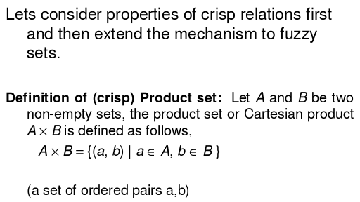
CRISP CARTESIAN PRODUCT

Slide 37
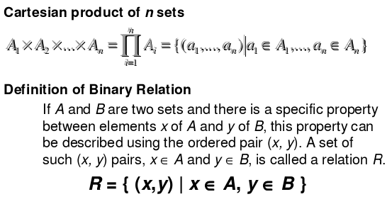
CRISP RELATIONS

Slide 38
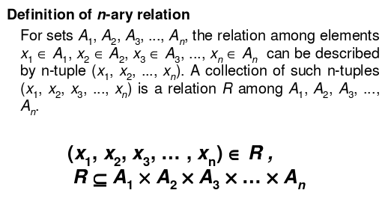
CRISP RELATIONS

Slide 39
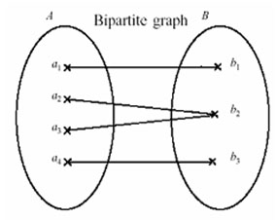
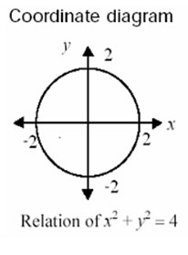
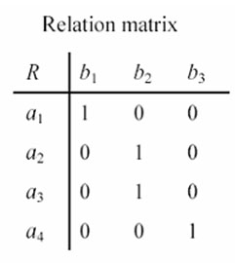
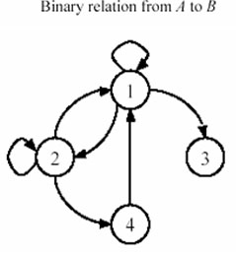
CRISP BINARY RELATIONS
Examples of binary relations

Slide 40
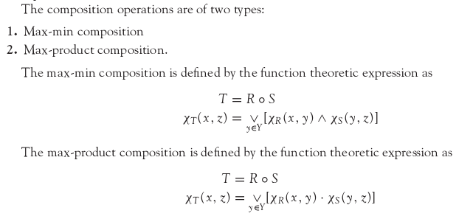
COMPOSITION ON CRISP RELATIONS

Slide 41
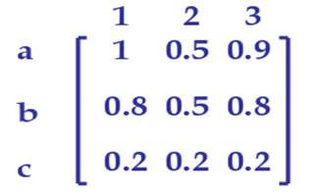
FUZZY CARTESIAN PRODUCT
Let R be a fuzzy subset of M and S be a fuzzy subset of N. Then the Cartesian product R × S is a fuzzy subset of N × M such that
Example:
Let R be a fuzzy subset of {a, b, c} such that R = a/1 + b/0.8 + c/0.2 and S be a fuzzy subset of {1, 2, 3} such that S = 1/1 + 3/0.8 + 2/0.5. Then R x S is given by

Slide 42
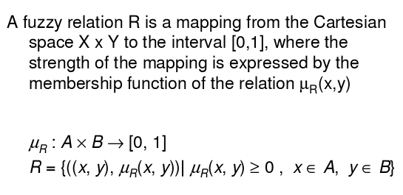
FUZZY RELATION

Slide 43
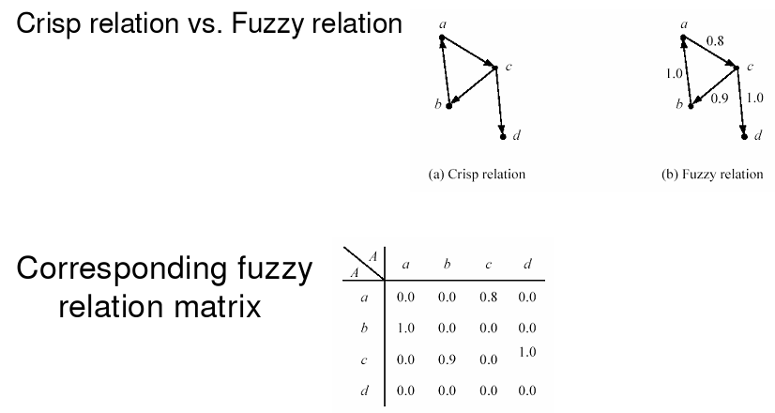
FUZZY RELATION

Slide 44

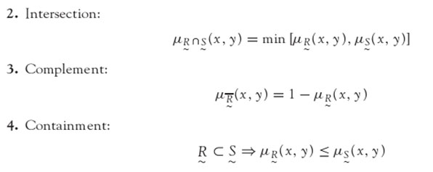
OPERATIONS ON FUZZY RELATION
The basic operation on fuzzy sets also apply on fuzzy relations.

Slide 45
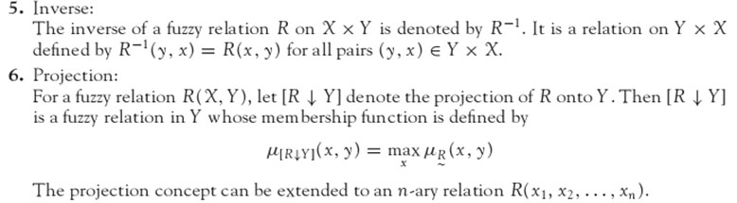
OPERATIONS ON FUZZY RELATION

Slide 46
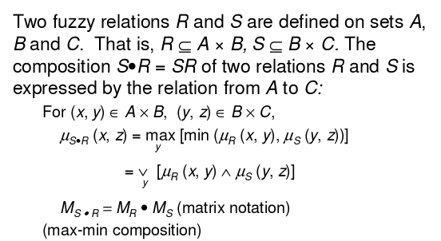
COMPOSITION OF FUZZY RELATIONS

Slide 47
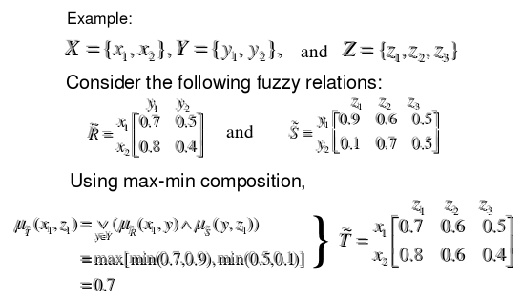
COMPOSITION OF FUZZY RELATIONS

Slide 48
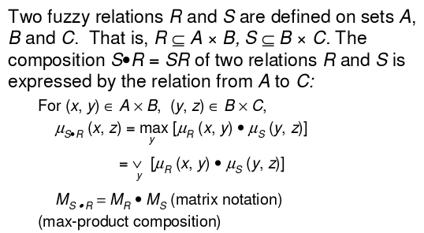
COMPOSITION OF FUZZY RELATIONS

Slide 49
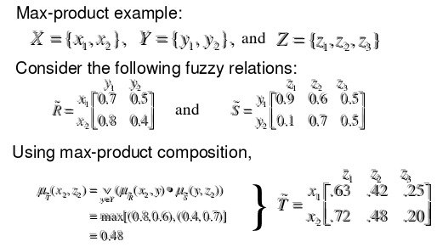
COMPOSITION OF FUZZY RELATIONS

Slide 50
Example
let us consider a relational system that relates Fast-Runners with Young by the following production rule PR1.
PR1: IF X-is Young
THEN X-is-a Fast-Runner.
Suppose the membership distribution of subset Young is given in the following form:
Young = {10 / 0.1, 20 / 0.6, 30 / 0.8, 40 / 0.6}
Fast-Runner = {5 / 0.1, 8 / 0.2, 10 / 0.4, 12 / 0.9}

Slide 51
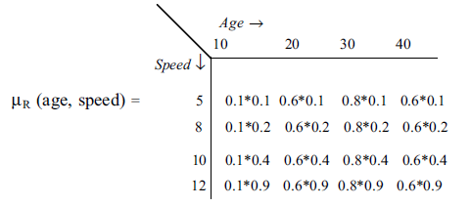
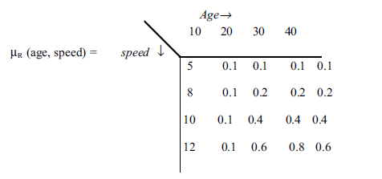
Example contd..
The relation obtained through a Cartesian product can be denoted as μ_{R}(age,speed).

Slide 52
Example contd..
Now, suppose that the measured distribution of a young person is as follows:
Young = { 10 / 0.01, 20 / 0.8, 30 / 0.7, 40 / 0.6}
Now, the fuzzy membership distribution of the person being a Fast-Runner can be estimated by post-multiplying the relational matrix by the Young vector. Thus,
The estimated membership distribution in the present context becomes

Slide 53
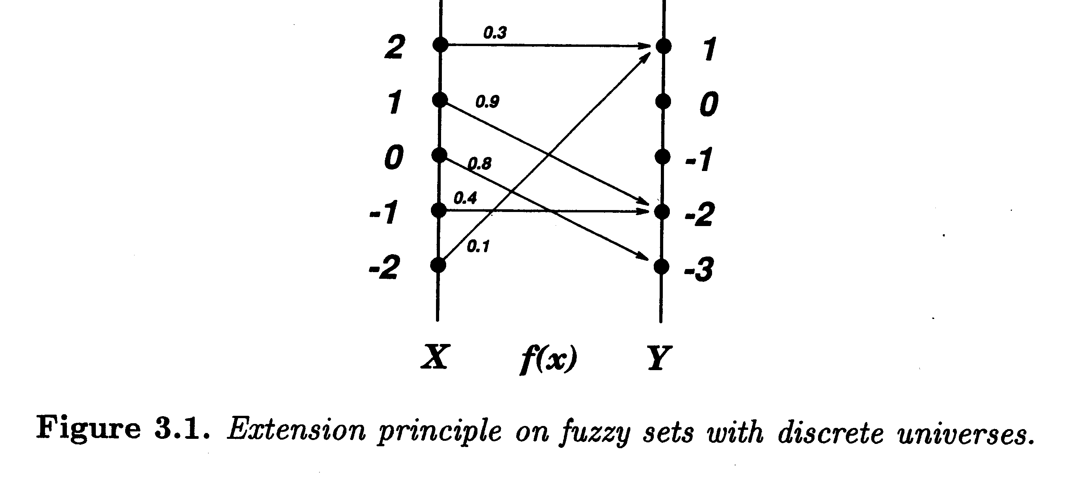
Extension Principle
A basic concept of fuzzy set theory that provides a general procedure for extending crisp domains of mathematical expressions to fuzzy domain.
it generalizes a common point-to-point mapping of a fun f(⋅) to a mapping b/t fuzzy sets.
Notes:
A fuzzy set is a set with fuzzy boundary. Suppose that A is the set of tall people. In a conventional set, or crisp set, an element is either belong to not belong to a set; there nothing in between. Therefore to define a crisp set A, we need to find a number, say, 5??, such that for a person taller than this number, he or she is in the set of tall people. For a fuzzy version of set A, we allow the degree of belonging to vary between 0 and 1. Therefore for a person with height 5??, we can say that he or she is tall to the degree of 0.5. And for a 6-foot-high person, he or she is tall to the degree of .9. So everything is a matter of degree in fuzzy sets. If we plot the degree of belonging w.r.t. heights, the curve is called a membership function. Because of its smooth transition, a fuzzy set is a better representation of our mental model of all? Moreover, if a fuzzy set has a step-function-like membership function, it reduces to the common crisp set.

Slide 54
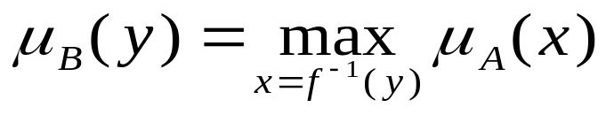
Extension Principle
A is a fuzzy set on X :
The image of A under f(⋅) is a fuzzy set B:
f(A)=
where yi = f(xi), i = 1 to n, µ_{A}(x_{i} )=µ_{B}(x_{i}).
If f(⋅) is a many-to-one mapping, then
Notes:
A fuzzy set is a set with fuzzy boundary. Suppose that A is the set of tall people. In a conventional set, or crisp set, an element is either belong to not belong to a set; there nothing in between. Therefore to define a crisp set A, we need to find a number, say, 5??, such that for a person taller than this number, he or she is in the set of tall people. For a fuzzy version of set A, we allow the degree of belonging to vary between 0 and 1. Therefore for a person with height 5??, we can say that he or she is tall to the degree of 0.5. And for a 6-foot-high person, he or she is tall to the degree of .9. So everything is a matter of degree in fuzzy sets. If we plot the degree of belonging w.r.t. heights, the curve is called a membership function. Because of its smooth transition, a fuzzy set is a better representation of our mental model of all? Moreover, if a fuzzy set has a step-function-like membership function, it reduces to the common crisp set.

Slide 55
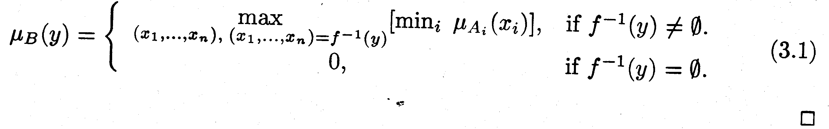
Definition: Extension Principle
Suppose that function f is a mapping from an n-dimensional Cartesian product space X₁ × X₂ × … × X_{n} to a 1-dimensional universe Y s.t. y=f(x₁, …, x_{n}), and suppose A₁, …, A_{n} are n fuzzy sets in X₁, …, X_{n}, respectively.
Then, the extension principle asserts that the fuzzy set B induced by the mapping f is defined by

Slide 56
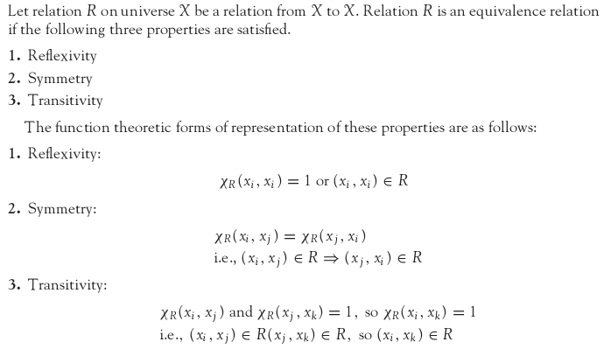
CLASSICAL EQUIVALENCE RELATION

Slide 57
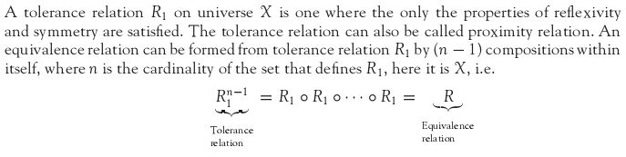
CLASSICAL TOLERANCE RELATION

Slide 58
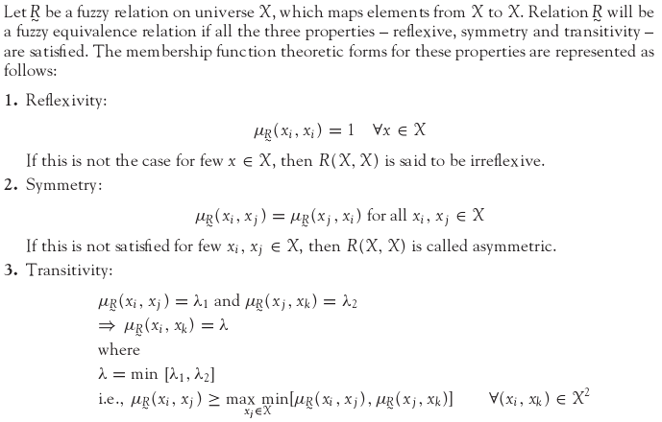
FUZZY EQUIVALENCE RELATION

Slide 59

FUZZY TOLERANCE RELATION
A binary fuzzy relation that possesses the properties of reflexivity and symmetry is called fuzzy tolerance relation or resemblance relation.
The equivalence relations are a special case of the tolerance relation. The fuzzy tolerance relation can be reformed into fuzzy equivalence relation in the same way as a crisp tolerance relation is reformed into crisp equivalence relation, i.e.,
where ‘n’ is the cardinality of the set that defines R₁.

Slide 60
Linguistic Variables and Hedges
At the root of fuzzy set theory lies the idea of linguistic variables.
A linguistic variable is a fuzzy variable. For example, the statement “John is tall” implies that the linguistic variable John takes the linguistic value tall.
In fuzzy expert systems, linguistic variables are used in fuzzy rules. For example:
IF wind is strong
THEN sailing is good
IF project_duration is long
THEN completion_risk is high
IF speed is slow
THEN stopping_distance is short

Slide 61
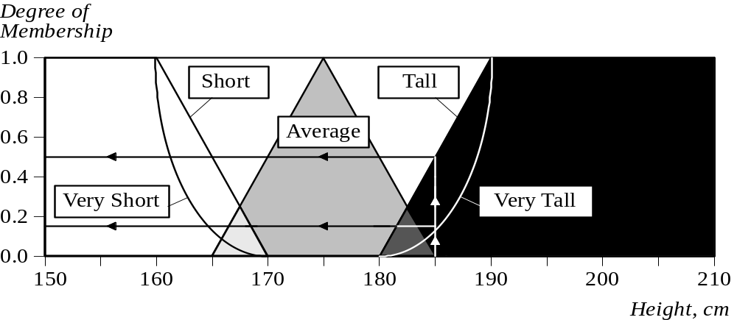
Linguistic Variables and Hedges
The range of possible values of a linguistic variable represents the universe of discourse of that variable. For example, the universe of discourse of the linguistic variable speed might have the range between 0 and 220 km/h and may include such fuzzy subsets as very slow, slow, medium, fast, and very fast.
A linguistic variable carries with it the concept of fuzzy set qualifiers, called hedges.
Hedges are terms that modify the shape of fuzzy sets. They include adverbs such as very, somewhat, quite, more or less and slightly.

Slide 62
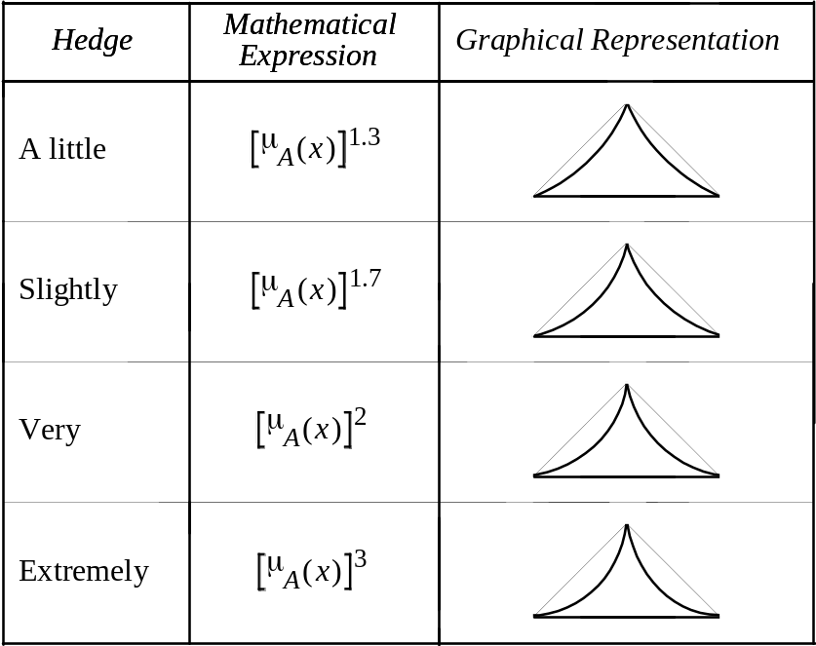
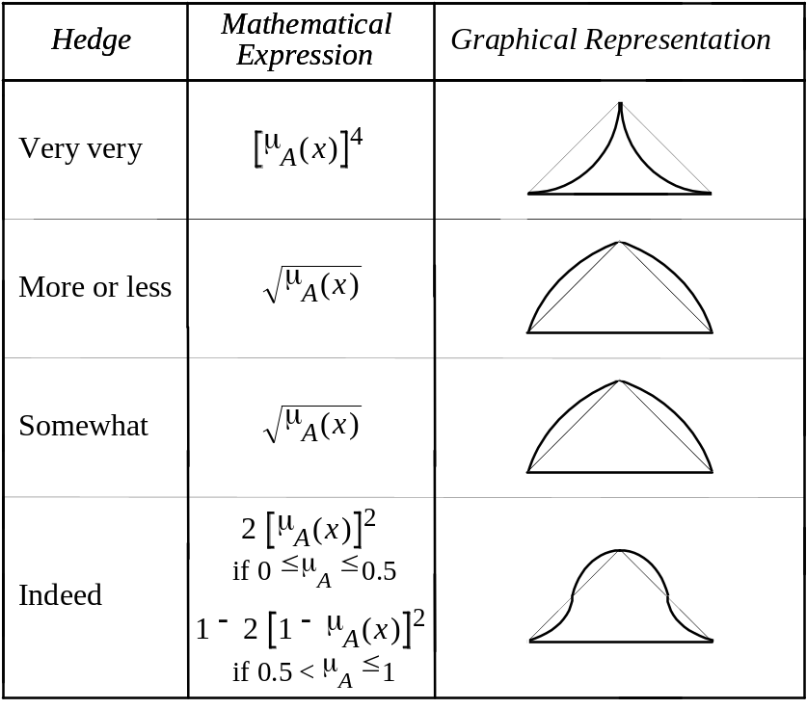
Linguistic Variables and Hedges

Slide 63
Fuzzy Rules
In 1973, Lotfi Zadeh published his second most influential paper. This paper outlined a new approach to analysis of complex systems, in which Zadeh suggested capturing human knowledge in fuzzy rules.
A fuzzy rule can be defined as a conditional statement in the form:
IF x is A
THEN y is B
where x and y are linguistic variables; and A and B are linguistic values determined by fuzzy sets on the universe of discourses X and Y, respectively.

Slide 64
Classical Vs Fuzzy Rules
A classical IF-THEN rule uses binary logic, for example,
Rule: 1 Rule: 2
IF speed is > 100 IF speed is < 40
THEN stopping_distance is long THEN stopping_distance is short
The variable speed can have any numerical value between 0 and 220 km/h, but the linguistic variable stopping distance can take either value long or short. In other words, classical rules are expressed in the black-and-white language of Boolean logic.
We can also represent the stopping distance rules in a fuzzy form:
Rule: 1 Rule: 2
IF speed is fast IF speed is slow
THEN stopping_distance is long THEN stopping_distance is short
In fuzzy rules, the linguistic variable speed also has the range (the universe of discourse) between 0 and 220 km/h, but this range includes fuzzy sets, such as slow, medium and fast. The universe of discourse of the linguistic variable stopping_distance can be between 0 and 300 m and may include such fuzzy sets as short, medium and long.

Slide 65
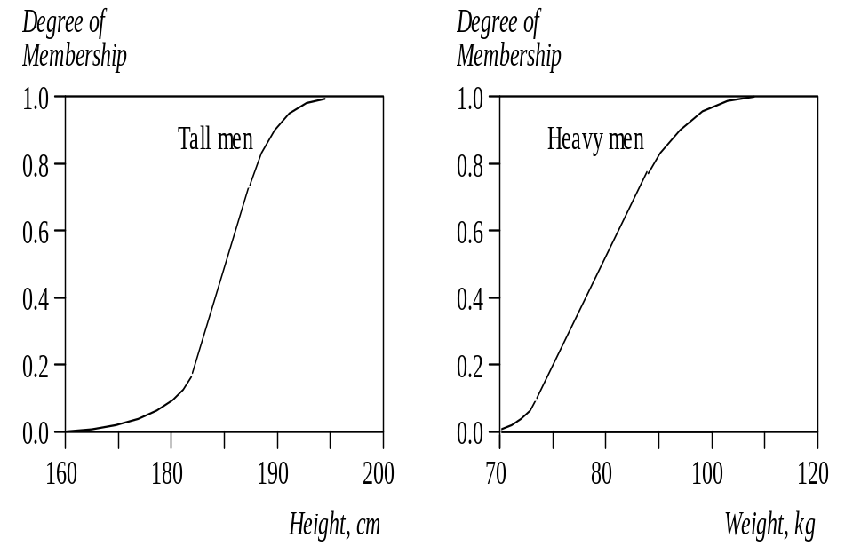
Firing Fuzzy Rules
These fuzzy sets provide the basis for a weight estimation model. The model is based on a relationship between a man’s height and his weight:
IF height is tall
THEN weight is heavy

Slide 66
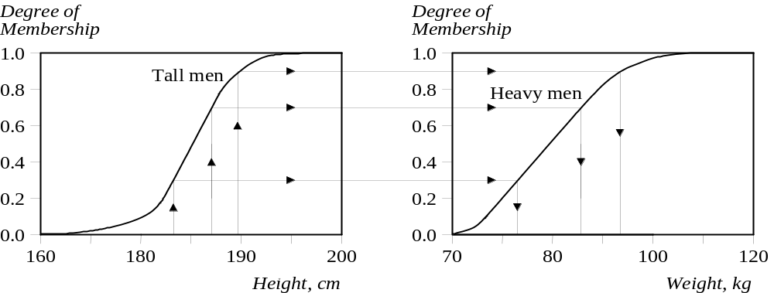
Firing Fuzzy Rules
The value of the output or a truth membership grade of the rule consequent can be estimated directly from a corresponding truth membership grade in the antecedent. This form of fuzzy inference uses a method called monotonic selection.

Slide 67
Firing Fuzzy Rules
A fuzzy rule can have multiple antecedents, for example:
IF project_duration is long
AND project_staffing is large
AND project_funding is inadequate
THEN risk is high
IF service is excellent
OR food is delicious
THEN tip is generous
The consequent of a fuzzy rule can also include multiple parts, for instance:
IF temperature is hot
THEN hot_water is reduced;
cold_water is increased

Slide 68
Fuzzy Propositional
A fuzzy proposition is a statement P which acquires a fuzzy truth value T(P) .
Example :
P : Ram is honest
T(P) = 0.8 , means P is partially true.T(P) = 1 , means P is absolutely true.

Slide 69
Fuzzy Connectives
The fuzzy logic is similar to crisp logic supported by connectives.
Table below illustrates the definitions of fuzzy connectives.
Table : Fuzzy Connectves
Connective Symbols Usage Definition
Nagation ¬ ¬ P 1 – T(P)
Disjuction ∨ P ∨ Q Max[T(P) , T(Q)]
Conjuction ∧ P ∧ Q min[T(P) , T(Q)]
Implication ⇒ P ⇒ Q ¬P ∨ Q = max (1-T(P), T(Q)]
Here P , Q are fuzzy proposition and T(P) , T(Q) are their truth values.
− the P and Q are related by the ⇒ operator are known as antecedents and consequent respectively.
− as crisp logic, here in fuzzy logic also the operator ⇒ represents
IF-THEN statement like, IF x is A THEN y is B, is equivalent to
R = (A x B) U (¬ A x Y)
the membership function of R is given by
μR (x , y) = max [min (μA (x) , μB (y)) , 1 − μA (x)]
− For the compound implication statement like
IF x is A THEN y is B, ELSE y is C is equivalent to R = (A x B) U (¬ A x C)
the membership function of R is given by
μR (x , y) = max [min (μA (x) , μB (y)) , min (1 − μA (x), μC (y))]

Slide 70
Example 1 :
P : Mary is efficient , T(P) = 0.8 ,
Q : Ram is efficient , T(Q) = 0.65 ,
¬ P : Mary is efficient , T(¬ P) = 1 − T(P) = 1− 0.8 = 0.2
P ∧ Q : Mary is efficient and so is Ram, i.e.
T(P ∧ Q) = min (T(P), T(Q)) = min (0.8, 0.65)) = 0.65
P ∨ Q : Either Mary or Ram is efficient i.e.
T(P ∨ Q) = max (T(P), T(Q)) = max (0.8, 0.65)) = 0.8
P ⇒ Q : If Mary is efficient then so is Ram, i.e.
T(P ⇒ Q) = max (1− T(P), T(Q)) = max (0.2, 0.65)) = 0.65

Slide 71
Example 2
X = {a, b, c, d}, Y = { 1, 2, 3, 4} the universe of discourse
A = {(a, 0) (b, 0.8) (c, 0.6) (d, 1)}, B = {(1, 0.2) (2, 1) (3, 0.8) (4, 0)}
C = {(1, 0) (2, 0.4) (3, 1) (4, 0.8)}
Determine the implication relations
(i) If x is A THEN y is B (ii) If x is A THEN y is B Else y is C
Solution
To determine implication relations (i) compute :
The operator ⇒ represents IF-THEN statement like,
IF x is A THEN y is B, is equivalent to R = (A x B) U (¬ A x Y) and
the membership function R is given by
μR (x , y) = max [min (μA (x) , μB (y)) , 1 − μA (x)]
Fuzzy Intersection A x B is defined as : for all x in the set X,
(A ∩ B)(x) = min [A(x), B(x)],
Fuzzy Intersection ¬A x Y is defined as :
for all x in the set X, (¬A ∩ Y)(x) = min [A(x), Y(x)],

Slide 72
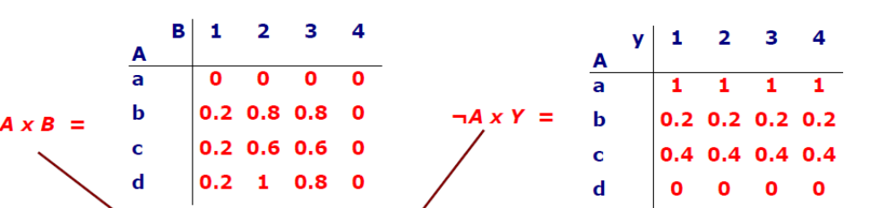
Example 2 contd…
Fuzzy Union is defined as (A ∪ B)(x) = max [A(x), B(x)] for all x ∈ X
Therefore R = (A x B) U (¬ A x Y) gives
y 1 2 3 4
x
a 1 1 1 1
b 0.2 0.8 0.8 0
c 0.4 0.6 0.6 0.4
d 0.2 1 0.8 0
This represents If x is A THEN y is B ie T(A ⇒ B) = max (1- T(A), T(B))

Slide 73
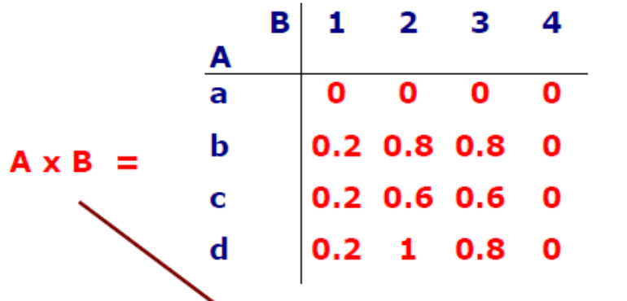
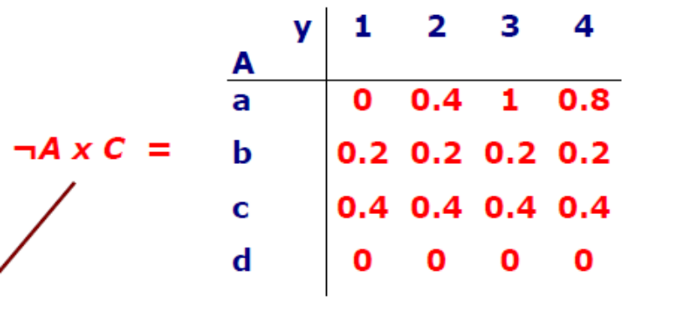
Example 2 contd…
To determine implication relations (ii) compute :
the operator ⇒ represents IF-THEN-ELSE statement like,
IF x is A THEN y is B Else y is C, is equivalent to R = (A x B) U (¬ A x C) and
the membership function of R is given by
μR (x , y) = max [min (μA (x) , μB (y)) , min(1 − μA (x), μC (y)]
Fuzzy Intersection A x B is defined as : for all x in the set X,(A ∩ B)(x) = min [A(x), B(x)],
Fuzzy Intersection ¬A x Y is defined as :for all x in the set X, (¬A ∩ C)(x) = min [A(x), C(x)],

Slide 74
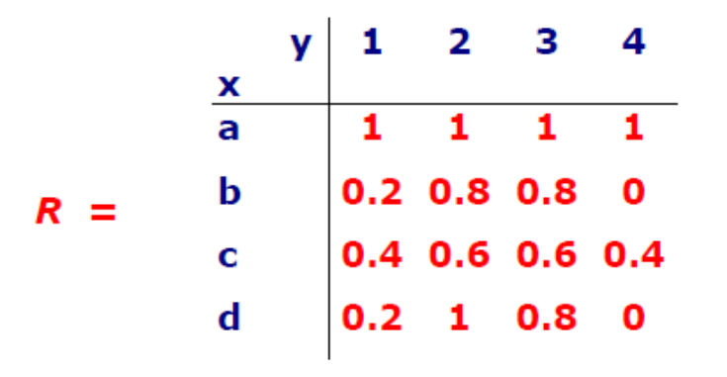
Example 2 contd…
Fuzzy Union is defined as (A ∪ B)(x) =
max [A(x), B(x)] for all x ∈ X
Therefore R = (A x B) U (¬ A x C) gives
This represents If x is A THEN y is B Else y is C

Slide 75
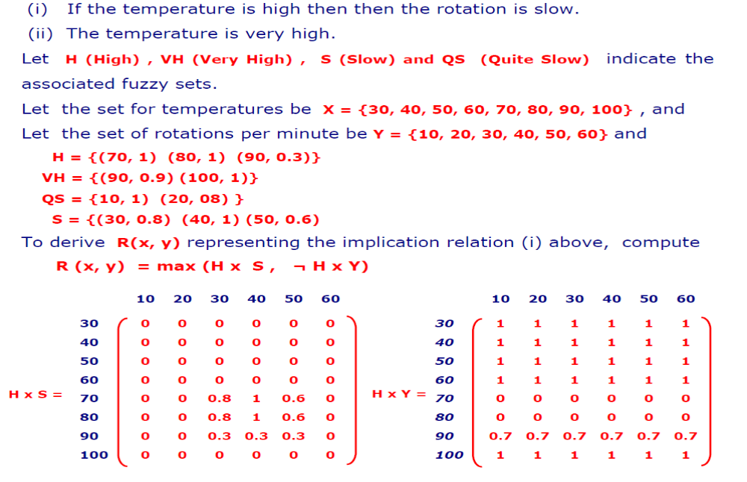
Example

Slide 76
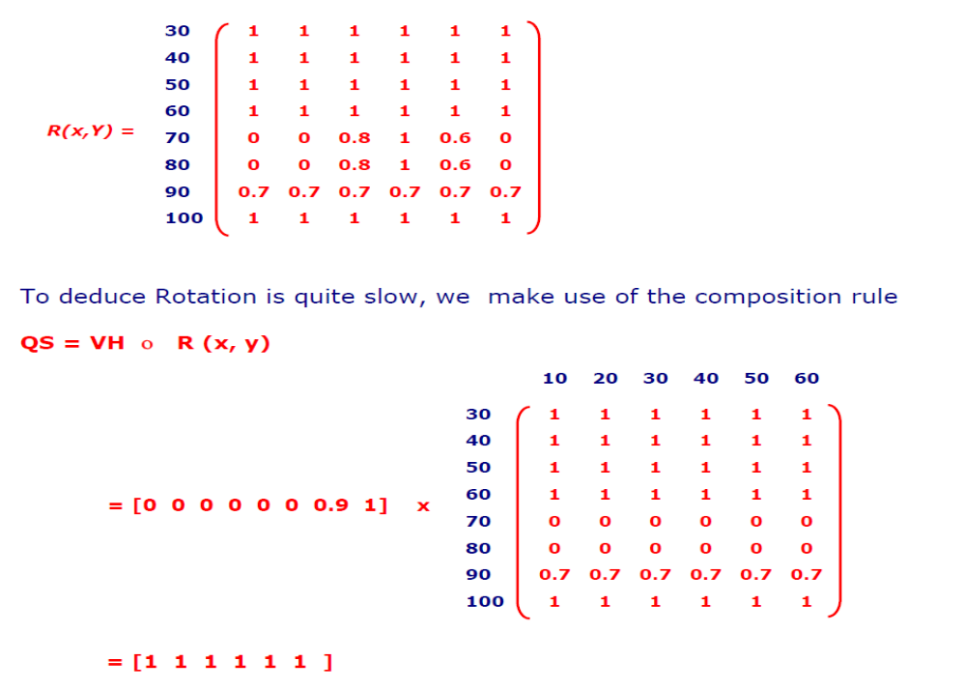
Example contd….

Slide 77
Fuzzy Sets Example
Air-conditioning involves the delivery of air which can be warmed or cooled and have its humidity raised or lowered.
An air-conditioner is an apparatus for controlling, especially lowering, the temperature and humidity of an enclosed space. An air-conditioner typically has a fan which blows/cools/circulates fresh air and has cooler and the cooler is under thermostatic control. Generally, the amount of air being compressed is proportional to the ambient temperature.
Consider Johnny’s air-conditioner which has five control switches: COLD, COOL, PLEASANT, WARM and HOT. The corresponding speeds of the motor controlling the fan on the air-conditioner has the graduations: MINIMAL, SLOW, MEDIUM, FAST and BLAST.

Slide 78
Fuzzy Sets Example
The rules governing the air-conditioner are as follows:
RULE 1:
  IF TEMP is COLD THEN SPEED is MINIMAL
RULE 2:
  IF TEMP is COOL THEN SPEED is SLOW
RULE 3:
  IF TEMP is PLEASANT THEN SPEED is MEDIUM
RULE 4:
  IF TEMP is WARM THEN SPEED is FAST
RULE 5:
  IF TEMP is HOT THEN SPEED is BLAST

Slide 79
Fuzzy Sets Example
The temperature graduations are related to Johnny’s perception of ambient temperatures.
where:
Y : temp value belongs to the set (0<μ_{A}(x)<1)
Y* : temp value is the ideal member to the set (μ_{A}(x)=1)
N : temp value is not a member of the set (μ_{A}(x)=0)
Temp (⁰C). | COLD | COOL | PLEASANT | WARM | HOT
0 | Y* | N | N | N | N
5 | Y | Y | N | N | N
10 | N | Y | N | N | N
12.5 | N | Y* | N | N | N
15 | N | Y | N | N | N
17.5 | N | N | Y* | N | N
20 | N | N | N | Y | N
22.5 | N | N | N | Y* | N
25 | N | N | N | Y | N
27.5 | N | N | N | N | Y
30 | N | N | N | N | Y*

Slide 80
Fuzzy Sets Example
Johnny’s perception of the speed of the motor is as follows:
where:
Y : temp value belongs to the set (0<μ_{A}(x)<1)
Y* : temp value is the ideal member to the set (μ_{A}(x)=1)
N : temp value is not a member of the set (μ_{A}(x)=0)
Rev/sec (RPM) | MINIMAL | SLOW | MEDIUM | FAST | BLAST
0 | Y* | N | N | N | N
10 | Y | N | N | N | N
20 | Y | Y | N | N | N
30 | N | Y* | N | N | N
40 | N | Y | N | N | N
50 | N | N | Y* | N | N
60 | N | N | N | Y | N
70 | N | N | N | Y* | N
80 | N | N | N | Y | Y
90 | N | N | N | N | Y
100 | N | N | N | N | Y*

Slide 81
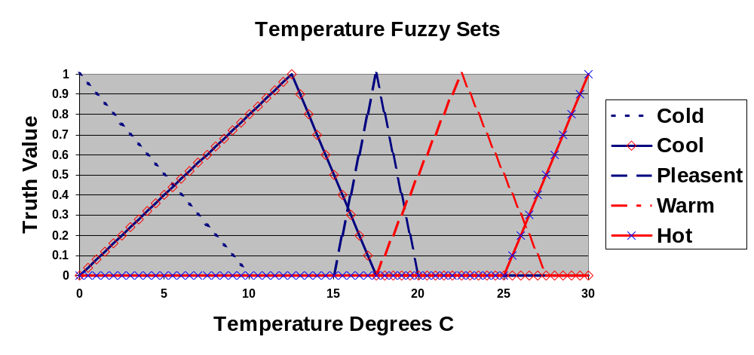
Fuzzy Sets Example

Slide 82
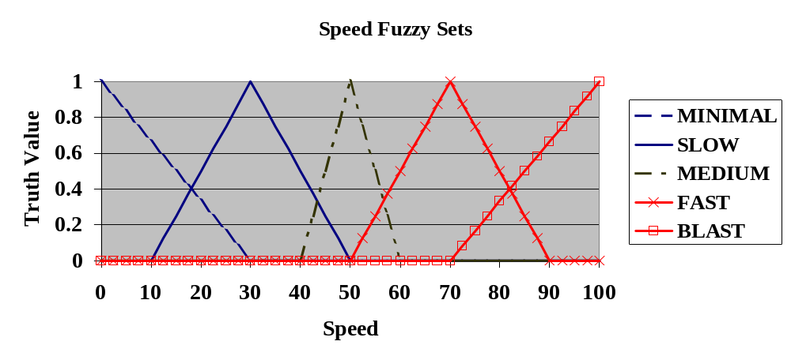
Fuzzy Sets Example

Slide 83
Exercises
For
  A = {0.2/a, 0.4/b, 1/c, 0.8/d, 0/e}
  B = {0/a, 0.9/b, 0.3/c, 0.2/d, 0.1/e}
Draw the Fuzzy Graph of A and B
Then, calculate the following:
- Support, Core, Cardinality, and Complement for A and B independently
- Union and Intersection of A and B
- the new set C, if C = A²
- the new set D, if D = 0.5B
- the new set E, for an alpha cut at A_{0.5}

Slide 84
Solutions
A = {0.2/a, 0.4/b, 1/c, 0.8/d, 0/e}
B = {0/a, 0.9/b, 0.3/c, 0.2/d, 0.1/e}
Support
  Supp(A) = {a, b, c, d}
  Supp(B) = {b, c, d, e}
Core
  Core(A) = {c}
  Core(B) = {}
Cardinality
  Card(A) = 0.2 + 0.4 + 1 + 0.8 + 0 = 2.4
  Card(B) = 0 + 0.9 + 0.3 + 0.2 + 0.1 = 1.5
Complement
  Comp(A) = {0.8/a, 0.6/b, 0/c, 0.2/d, 1/e}
  Comp(B) = {1/a, 0.1/b, 0.7/c, 0.8/d, 0.9/e}
Union
  AB = {0.2/a, 0.9/b, 1/c, 0.8/d, 0.1/e}
Intersection
  AB = {0/a, 0.4/b, 0.3/c, 0.2/d, 0/e}
C=A²
  C = {0.04/a, 0.16/b, 1/c, 0.64/d, 0/e}
D = 0.5B
  D = {0/a, 0.45/b, 0.15/c, 0.1/d, 0.05/e}
E = A_{0.5}
  E = {c, d}

Slide 85
Fuzzy Inference
Fuzzy Inferencing is the core element of a fuzzy system.
Fuzzy Inferencing combines - the facts obtained from the fuzzification with the
rule base, and then conducts the fuzzy reasoning process.
Fuzzy Inference is also known as approximate reasoning.
Fuzzy Inference is computational procedures used for evaluating linguistic descriptions. Two important inferring procedures are
− Generalized Modus Ponens (GMP)
− Generalized Modus Tollens (GMT)

Slide 86
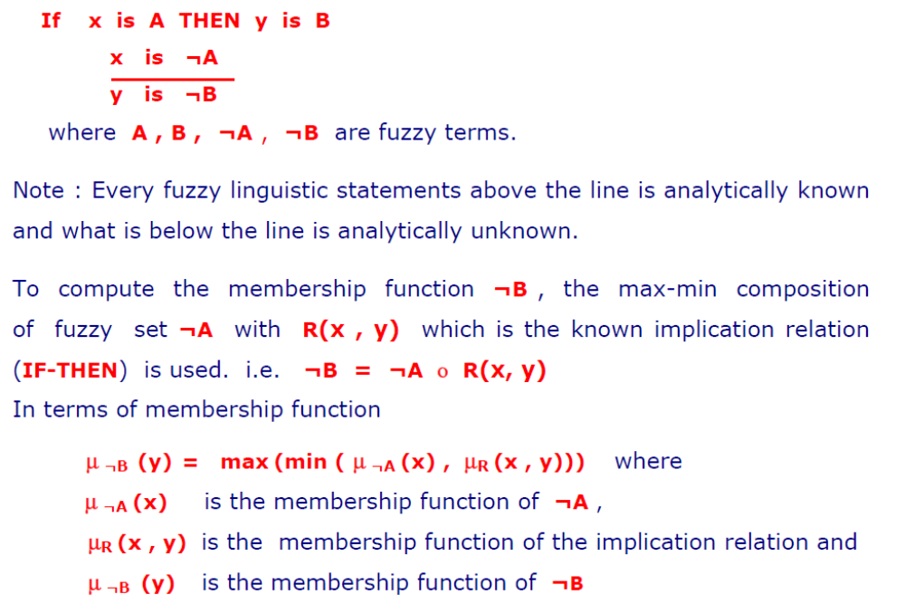
Generalized Modus Ponens (GMP)

Slide 87
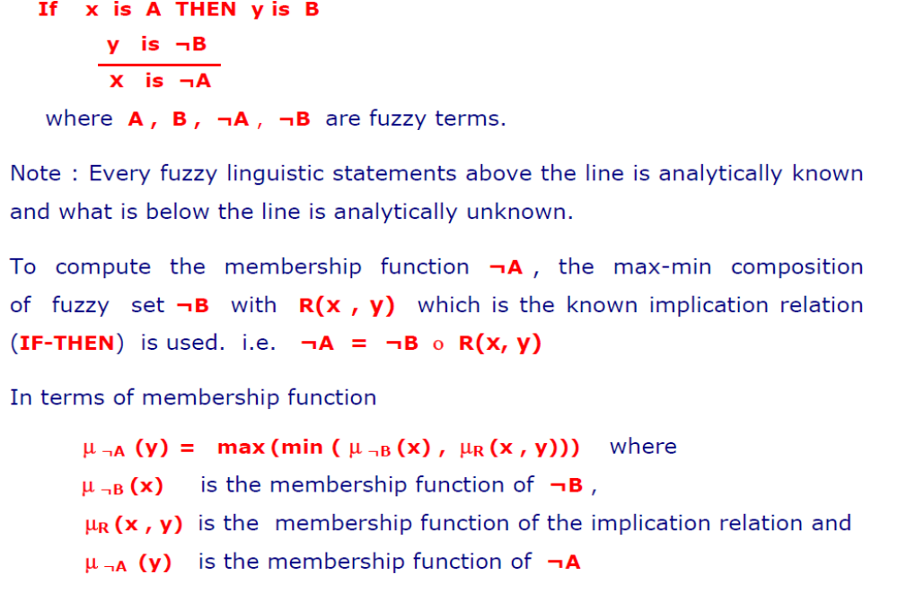
Generalized Modus Tollens (GMT)

Slide 88
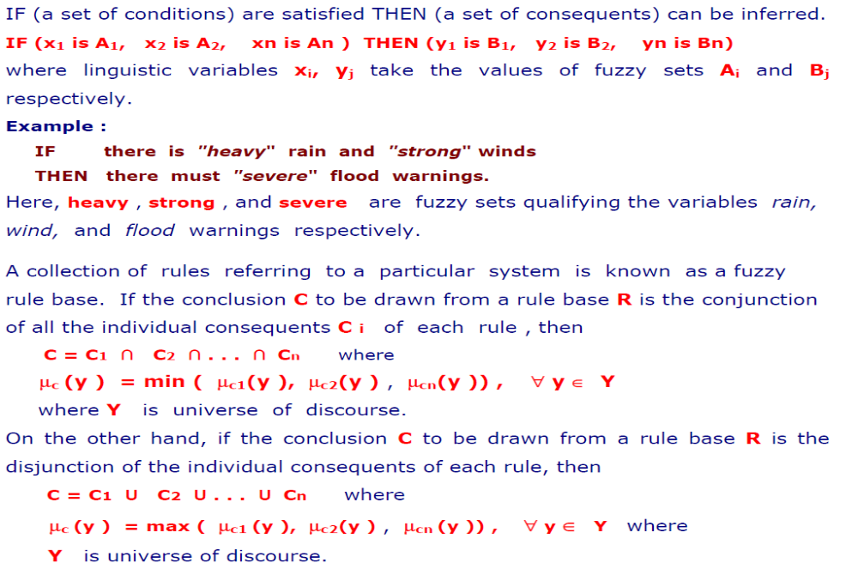
Fuzzy Rule Based System

Slide 89
Fuzzy Inference
The most commonly used fuzzy inference technique is the so-called Mamdani method.
In 1975, Professor Ebrahim Mamdani of London University built one of the first fuzzy systems to control a steam engine and boiler combination. He applied a set of fuzzy rules supplied by experienced human operators.

Slide 90
Mamdani Fuzzy Inference
The Mamdani-style fuzzy inference process is performed in four steps:
Fuzzification of the input variables
Rule evaluation (inference)
Aggregation of the rule outputs (composition)
Defuzzification.

Slide 91
Mamdani Fuzzy Inference
We examine a simple two-input one-output problem that includes three rules:
Rule: 1 Rule: 1
IF x is A3 IF project_funding is adequate
OR y is B1 OR project_staffing is small
THEN z is C1 THEN risk is low
Rule: 2 Rule: 2
IF x is A2 IF project_funding is marginal
AND y is B2 AND project_staffing is large
THEN z is C2 THEN risk is normal
Rule: 3 Rule: 3
IF x is A1 IF project_funding is inadequate
THEN z is C3 THEN risk is high

Slide 92
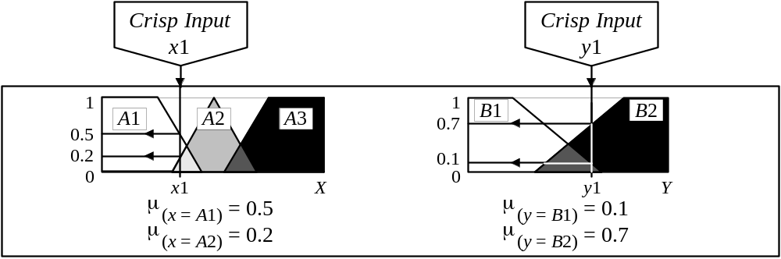
Step 1: Fuzzification
The fuzzification is a process of transforming crisp values into grades of membership for linguistic terms of fuzzy sets.
The first step is to take the crisp inputs, x1 and y1 (project funding and project staffing), and determine the degree to which these inputs belong to each of the appropriate fuzzy sets.

Slide 93
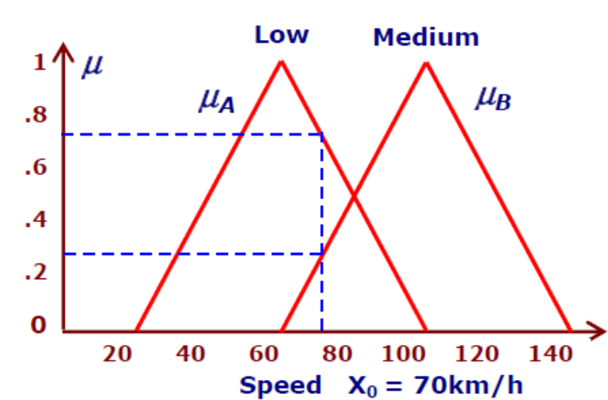

Fuzzification of the car speed
Example 1: Speed X0 = 70km/h
Given car speed value X0=70km/h : grade μA(x0) = 0.75 belongs to fuzzy low, and grade μB(x0) = 0.25 belongs to fuzzy medium
Example 2 : Speed X0 = 40km/h
Given car speed value X0=40km/h : grade μA(x0) = 0.6 belongs to fuzzy low, and grade μB(x0) = 0.4 belongs to fuzzy medium.

Slide 94
Step 2: Rule Evaluation
The second step is to take the fuzzified inputs, μ_{(x=A1)} = 0.5, μ_{(x=A2)} = 0.2, μ_{(y=B1)} = 0.1 and μ_{(y=B2)} = 0.7, and apply them to the antecedents of the fuzzy rules.
If a given fuzzy rule has multiple antecedents, the fuzzy operator (AND or OR) is used to obtain a single number that represents the result of the antecedent evaluation.
This number (the truth value) is then applied to the consequent membership function.
To evaluate the disjunction of the rule antecedents, we use the OR fuzzy operation. Typically, fuzzy expert systems make use of the classical fuzzy operation union:
    μ_{A∪B}(x) = max [μ_{A}(x), μ_{B}(x)]
Similarly, in order to evaluate the conjunction of the rule antecedents, we apply the AND fuzzy operation intersection:
    μ_{A∩B}(x) = min [μ_{A}(x), μ_{B}(x)]

Slide 95

Step 2: Rule Evaluation

Slide 96
Step 2: Rule Evaluation
Now the result of the antecedent evaluation can be applied to the membership function of the consequent.
There are two main methods for doing so:
  Clipping
  Scaling
The most common method of correlating the rule consequent with the truth value of the rule antecedent is to cut the consequent membership function at the level of the antecedent truth. This method is called clipping (alpha-cut).
Since the top of the membership function is sliced, the clipped fuzzy set loses some information.
However, clipping is still often preferred because it involves less complex and faster mathematics, and generates an aggregated output surface that is easier to defuzzify.

Slide 97

Step 2: Rule Evaluation
While clipping is a frequently used method, scaling offers a better approach for preserving the original shape of the fuzzy set.
The original membership function of the rule consequent is adjusted by multiplying all its membership degrees by the truth value of the rule antecedent.
This method, which generally loses less information, can be very useful in fuzzy expert systems.
clipping
scaling

Slide 98

Step 3: Aggregation of the rule outputs
Aggregation is the process of unification of the outputs of all rules.
We take the membership functions of all rule consequents previously clipped or scaled and combine them into a single fuzzy set.
The input of the aggregation process is the list of clipped or scaled consequent membership functions, and the output is one fuzzy set for each output variable.

Slide 99
DEFUZZIFICATION
Defuzzification is a mapping process from a space of fuzzy control actions defined over an output universe of discourse into a space of crisp (nonfuzzy) control actions.
Defuzzification is a process of converting output fuzzy variable into a unique number .
Defuzzification process has the capability to reduce a fuzzy set into a crisp single-valued quantity or into a crisp set; to convert a fuzzy matrix into a crisp matrix; or to convert a fuzzy number into a crisp number.

Slide 100
METHODS OF DEFUZZIFICATION
Defuzzification is the process of conversion of a fuzzy quantity
into a precise quantity. Defuzzification methods include:
        Max-membership principle,
        Centroid method,
        Weighted average method,
        Mean-max membership,
        Center of sums,
        Center of largest area,
        First of maxima, last of maxima.

Slide 101

FUZZY DECISION

Slide 102

MAX MEMBERSHIP METHOD
Fuzzy set with the largest membership value is selected.
Fuzzy decision: Fn = {P, F. G, VG, E}
Fn = {0.6, 0.4, 0.2, 0.2, 0}
Final decision (FD) = Poor Student
If two decisions have same membership max, use the average of the two.

Slide 103

CENTROID METHOD
This method is also known as center-of-mass, center-of-area, or center-of-gravity method. It is the most commonly used defuzzification method. The defuzzified output x* is defined as
where the symbol ∫ denotes an algebraic integration.

Slide 104


WEIGHTED AVERAGE METHOD

Slide 105



MEAN MAX MEMBERSHIP METHOD

Slide 106

CENTER OF SUMS
This method employs the algebraic sum of the individual fuzzy subsets instead of their unions. The calculations here are very fast but the main drawback is that the intersecting areas are added twice. The defuzzified value x* is given by

Slide 107


CENTER OF LARGEST AREA
This method can be adopted when the output consists of at least two convex fuzzy subsets which are not overlapping. The output in this case is biased towards a side of one membership function. When output fuzzy set has at least two convex regions then the center-of-gravity of the convex fuzzy subregion having the largest area is used to obtain the defuzzified value x*. This value is given by
where is the convex subregion that has the largest area making up

Slide 108


FIRST OF MAXIMA (LAST OF MAXIMA)
The steps used for obtaining crisp values are as follows:

Slide 109

Step 4: Defuzzification
The last step in the fuzzy inference process is de-fuzzification.
Fuzziness helps us to evaluate the rules, but the final output of a fuzzy system has to be a crisp number.
The input for the de-fuzzification process is the aggregate output fuzzy set and the output is a single number.
There are several defuzzification methods, but probably the most popular one is the centroid technique. It finds the point where a vertical line would slice the aggregate set into two equal masses.
Centroid defuzzification method finds a point representing the centre of gravity of the fuzzy set, A, on the interval, ab.
A reasonable estimate can be obtained by calculating it over a sample of points.

Slide 110
Sugeno Fuzzy Inference
Mamdani-style inference, as we have just seen, requires us to find the centroid of a two-dimensional shape by integrating across a continuously varying function. In general, this process is not computationally efficient.
Michio Sugeno suggested to use a single spike, a singleton, as the membership function of the rule consequent.
A singleton, or more precisely a fuzzy singleton, is a fuzzy set with a membership function that is unity at a single particular point on the universe of discourse and zero everywhere else.
Sugeno-style fuzzy inference is very similar to the Mamdani method. Sugeno changed only a rule consequent. Instead of a fuzzy set, he used a mathematical function of the input variable. The format of the Sugeno-style fuzzy rule is
IF x is A
AND y is B
THEN z is f(x, y)
where x, y and z are linguistic variables; A and B are fuzzy sets on universe of discourses X and Y, respectively; and f(x, y) is a mathematical function.

Slide 111

Sugeno Fuzzy Inference
The most commonly used zero-order Sugeno fuzzy model applies fuzzy rules in the following form:
IF x is A AND y is B THEN z is k
where k is a constant.
In this case, the output of each fuzzy rule is constant. All consequent membership functions are represented by singleton spikes.

Slide 112

Sugeno Aggregation of the Rule Outputs

Slide 113


Sugeno Defuzzification
Weighted Average (WA)

Slide 114
Mamdani or Sugeno?
Mamdani method is widely accepted for capturing expert knowledge. It allows us to describe the expertise in more intuitive, more human-like manner. However, Mamdani-type fuzzy inference entails a substantial computational burden.
On the other hand, Sugeno method is computationally effective and works well with optimisation and adaptive techniques, which makes it very attractive in control problems, particularly for dynamic nonlinear systems.

